Slide 1
Large Language Models Cannot Self-Correct Reasoning Yet
Presented by:
Dayyan Ahmad (21L-5669)
Alber Abbas (21L-5623)
Ibrahim Ehsan (21L-5656)
Minahil (21L-5660)
(AI)

Slide 2
Table of contents
01
02
03
04
Introduction to Large Language Models (LLMs) and Self Correction
Experiment Overiew and Key Findings
Why LLMs Fail at Self Correction and Architectural Limitations of LLMs
Issues with Earlier Research
05
Conclusion

Slide 3
01
What is a Large Language Model?
(AI)

Slide 4
Large Language Model
Definition: A Large Language Model (LLM) is a machine learning model designed to generate human-like text by learning patterns from vast amounts of text data.
Examples of LLMs: GPT-3.5, GPT-4, Llama-2
Primary Function: LLMs predict the next word or token in a sequence, generating responses based on learned statistical patterns.

Slide 5

Importance of Self-Correction
Purpose of Self Correction
Improve accuracy and reduce errors.
Maintain consistency in long conversations.
Enhance trustworthiness for users.
Improve user experience by minimizing the need for manual corrections.
Key Focus:
Can LLMs truly fix their own reasoning mistakes without external help?

Slide 6
02
Experiment Overview and Key Findings
(AI)

Slide 7
Experiment Overview

Slide 8
Models Tested: GPT-3.5, GPT-4, GPT-4 Turbo, Llama-2
Problem Sets Used:
GSM8K: Grade school math problems
CommonSenseQA: Commonsense multiple-choice questions
HotpotQA: Complex questions requiring multiple reasoning steps
Self-Correction Process: Models were asked to:
Provide initial answers.
Review and correct answers (up to two corrections).

Slide 9
Key Findings

Slide 10
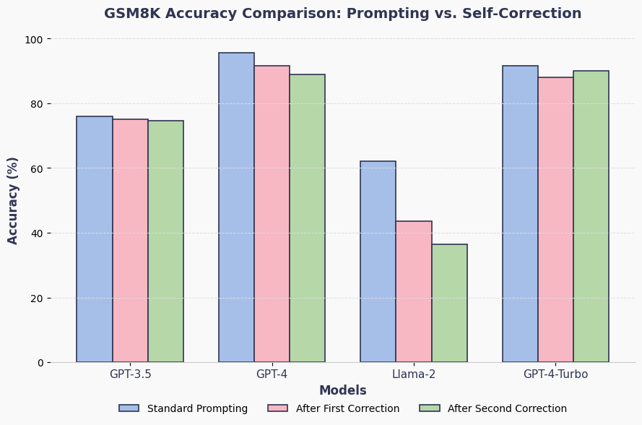
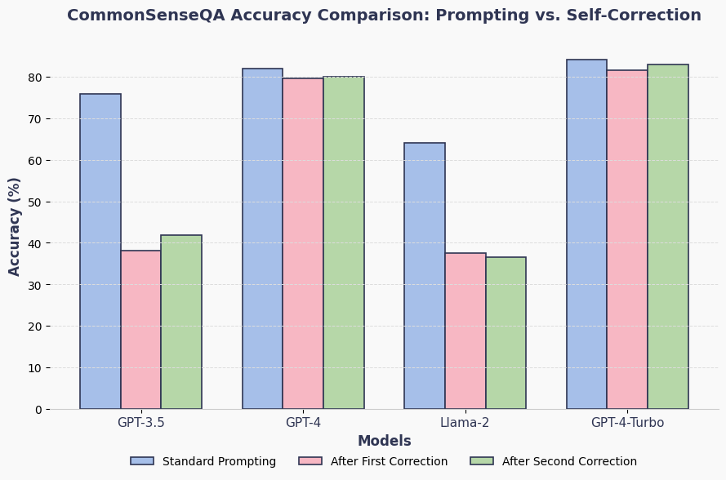
Surprising Result: Self-correction often worsened model performance, with correct answers turning into incorrect ones after attempting to self-correct.
Main Conclusion: LLMs fail to effectively self-correct reasoning mistakes on their own.

Slide 11
03
Why LLMs Fail at Self-Correction & Architectural Limitations
(AI)

Slide 12
Self-Correction
There are 2 types of Self-Corrections
(a) Intrinsic Self-Correction
The model can recognize and fix its own mistakes using only its internal processes—no help from outside sources like humans or tools. Essentially, it's the model "thinking on its own" to correct errors.
(b) Extrinsic Self-Correction
The model relies on outside help—like human feedback, additional algorithms, or external tools—to correct its mistakes.
Experiment Results: LLMs do not have the capacity for intrinsic self-correction; they tend to worsen their reasoning after attempting to correct themselves.

Slide 13
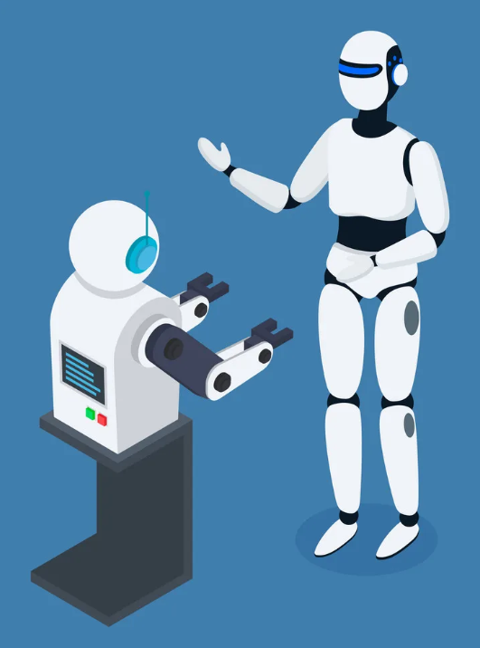
Multi-Agent Debate
Multiple LLM instances debate over the correctness of an answer
Agents:
One supports the original reasoning.
One challenges it by pointing out flaws.
A judge selects the best argument
Experiment Results:
Sometimes surface-level errors were fixed.
Deep reasoning flaws often persist or go unchallenged.
Debates can lead to agreement on wrong assumptions.
Even collaborative debate among LLMs does not reliably fix flawed reasoning chains.

Slide 14
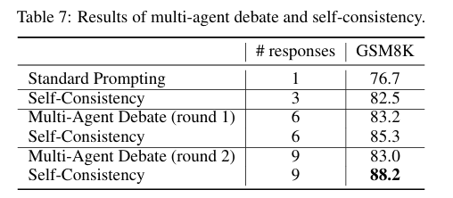
Multi-Agent Debate Results

Slide 15

Architectural Limitations of LLMs
How LLMs Work:
Embedding Layers: Map words into vectors.
Transformer Blocks: Process the sequence using attention and feed-forward operations.
Final Linear + Softmax Layers: Predict the next token.
Limitations:
LLMs are designed for prediction, not self-verification.
Lack of error detection, error localization, and error fixing mechanisms.
No memory or confidence estimation to track reasoning steps or measure certainty.

Slide 16
04
Issues With Earlier Research
(AI)

Slide 17
What were the Issues?
(a) Oracle Labels (Cheat Codes)
The model was given access to the correct answer during the correction process which is basically an unfair advantage.
(b) Bad Initial Prompts
The prompts were poorly designed which caused the models to fail at first. And any improvement later seemed more difficult than it was.
(c) Ignoring Model Call Costs
Previous researches didn’t account for the computational cost of making multiple model calls, leading to potentially inefficient and resource-heavy corrections.

Slide 18
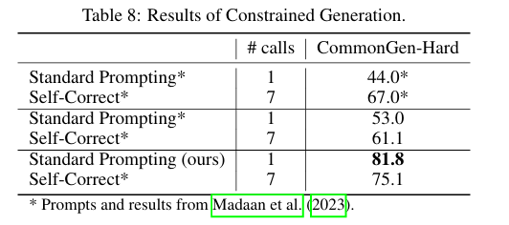
Bad Initial Prompts

Slide 19
The Stricter Approach of this Study
Realistic testing conditions
No oracle labels.
No reliance on bad initial prompts.
Computational costs accounted for.
Key Insight
LLMs don’t perform as well as earlier research suggests. Self-correction often worsens performance, and a more robust strategy is needed to improve reasoning.

Slide 20
05
Conclusion
(AI)

Slide 21
To Wrap it Up
Key Takeaways:
LLMs cannot reliably self-correct reasoning mistakes without external help.
Despite advancements in models like GPT-4, self-correction remains a limitation.
More sophisticated strategies are needed for improving reasoning abilities in LLMs.
Next Steps:
Researchers must explore other techniques to improve LLM reasoning capabilities.

Slide 22
Thank You

